Slide 1
Access Control
VPN
Group 4

Slide 2
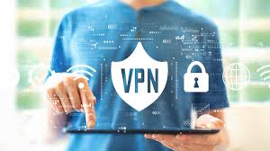
Agenda
Introduction
What is VPN?
Benefits of VPN
Types of VPN
Architecture in MOJO Inc
VPN Use Cases
Conclusion
Demo

Slide 3

Introduction
MOJO Inc. Product based company , delivering cybersecurity solutions to protect businesses against any cyber-attacks.

Slide 4

What is VPN?
A VPN, or Virtual Private Network, is a secure and encrypted connection between two devices over the internet, providing you online privacy and anonymity.

Slide 5
Benefits Of VPN
Geo-spoofing
VPNs allow users to change their IP address and unblock content.
1
2
3
Data Security
Remote Access
VPN encryption ensures data privacy and security while online.
Employees can securely access private company networks from home or remote locations.

Slide 6

Types of VPN
Remote Access VPN:
Provides secure access for remote users or devices to a private network over the internet.
Site-to-Site VPN (Intranet VPN):
Connects multiple remote locations or branch offices to create a secure network between them.
3. Open VPN:
OpenVPN is an open-source virtual private network (VPN) protocol and software solution that provides secure and encrypted communication over the internet

Slide 7
Authentication Protocols
Password-based Authentication
RADIUS (Remote Authentication Dial-In User Service)
TACACS+ (Terminal Access Controller Access-Control System Plus)
LDAP (Lightweight Directory Access Protocol)
Certificate-based Authentication
Public Key Infrastructure (PKI)
Smart Card Authentication
8. Multi-Factor Authentication (MFA)

Slide 8
Best Practises
Strong Authentication: Implement multi-factor authentication (MFA) and use strong passwords for VPN access.
Encryption: Enable strong encryption protocols (e.g., AES-256) to protect data in transit.
Access Control: Restrict VPN access to authorized users based on role and least privilege principles.
Logging & Monitoring: Monitor VPN activity and set up alerts for suspicious behavior.
Network Segmentation: Isolate VPN traffic from the internal network to minimize impact in case of breach.
User Education: Educate VPN users about security risks and best practices.
Two-Factor Authentication: Implement 2FA for VPN users.
Security Audits & Penetration Testing: Conduct regular security audits and penetration tests

Slide 9
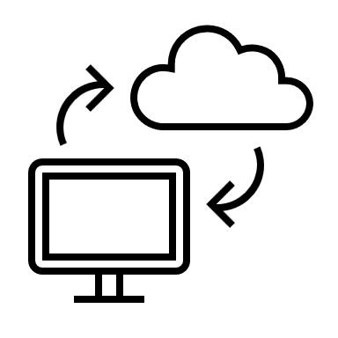

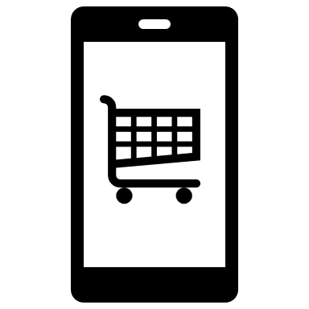
Common VPN Use Cases
Remote Workers
Online Shoppers
Travelers
Remote workers can connect to their company's network through a secure VPN connection, allowing them to access company resources and files from any location.
VPNs provide more secure online shopping experiences by encrypting all data sent between devices and online shopping stores.
Travelers can use VPNs to get past geo-restrictions, allowing them to access websites and services from any location.

Slide 10
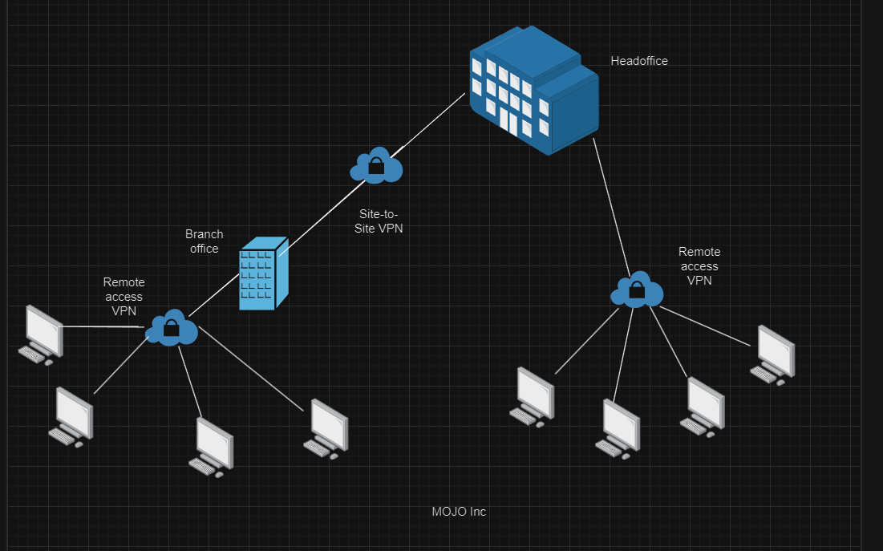
Architecture In MOJO Inc.

Slide 11

Conclusion
A VPN, or Virtual Private Network, is a secure and encrypted connection between two devices over the internet, providing you online privacy and anonymity.
VPN technology relies on encryption, tunneling, and masking of your IP address and location, making it an essential tool for online protection from various cyber threats. Be sure to select the right VPN provider and always read the security policies and protocols before using.

Slide 12
DEMO..

Slide 13
THANK YOU!!

